Slide 1
How mature is the law in its treatment of children and young people?
Dr. Laura Janes, Legal Director
Howard League for Penal Reform
October 2021

Slide 2
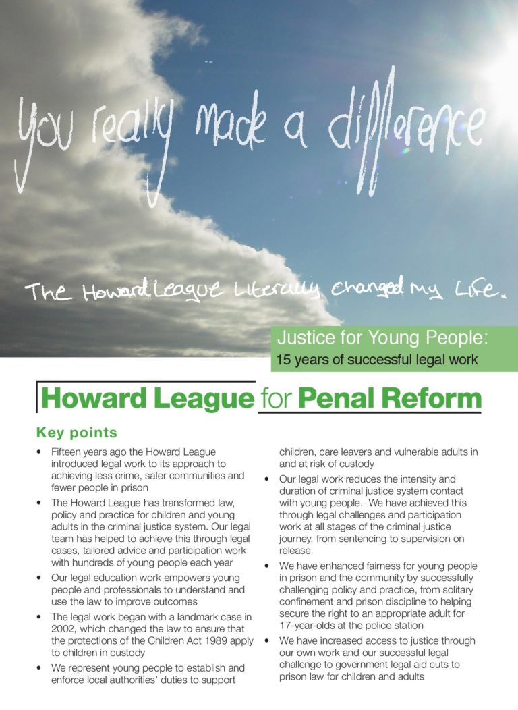
Using the law for change – the work of the Howard League
England and Wales, since 1866
Less crime, safer communities, fewer people in prison
Policy, research, direct legal work for young people aged 21 and under since 2002 – free legal advice line for young people in prison – open every morning
Membership organisation – no government funding
www.howardleague.org

Slide 3
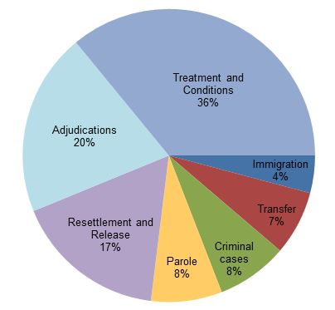
Our advice line
Over the last five years, we helped 4000 young people with 5000 pieces of legal advice plus legal education
Issues that we offer initial advice on include: treatment and conditions; health and wellbeing; discrimination; resettlement; and transfer
Issues raised in calls to the advice line

Slide 4
Inconsistent approaches to responsibility in law
1313
1963
1969
1998
Case in the Eyre of Kent
Children and Young Persons Act
Children and Young Persons Act
Crime and Disorder Act
Legal case finds children under seven could *not* be guilty of a crime
Children under ten cannot be guilty of a crime
Age of criminal responsibility raised to 14
never enforced
Abolished the need to prove a child aged between 10 and 14 knew what they were doing was wrong
Representation of the People Act
Voting age lowered from 21 to 18

Slide 5
Criminal v civil law
The age of criminal responsibility is 10, but children must be:
13 to enter employment
16 to consent to sex, play the lottery, get married (with the consent of a parent/guardian) or join the army
17 to drive a car
18 to enter a legally binding contract, buy alcohol, cigarettes or fireworks, sit on a jury, vote or get a tattoo
Attempts to raise the age of criminal responsibility have consistently failed
The most recent attempt by Baroness Butler-Sloss, who was a celebrated family law judge before entering the Lords, suggests 12

Slide 6
What about the reality of young peoples’ maturation?
https://howardleague.org/legal-work/sentencing-young-adults/

Slide 7
Not fair! civil and criminal justice inequalities
A child is a person under 18 (s105, Children Act 1989)
The law (within reason) accepts there should be a different approach for children
A child at the police station must have the support of an Appropriate Adult, only recently applied to 17 year olds in the case of HC in 2013
But is expected to be able to instruct a solicitor to defend them in court on criminal charges
In the civil courts you must have a litigation friend who instructs the solicitor on your behalf
So in HC, the same child had to tell his solicitor what to do in the criminal case but had to have a litigation friend to challenge the failure of the police to let him have an appropriate adult!

Slide 8
Not fair! civil and criminal justice inequalities
Lots of legal protections fall away at 18
Young adults are more likely to experience problems with housing and homelessness, welfare benefits, debt and discrimination.
Mental health problems and social welfare problems are often interlinked
Young adults who experience disadvantage for other reasons, such as being a lone parent, a care leaver or outside education, employment and training, are more likely to have civil legal problems
Young adults are also overrepresented in the criminal justice system: young adults aged 18 to 25 make up ten per cent of the general population but 30 per cent of police cases (Bennett and Corry-Roake, 2021)

Slide 9
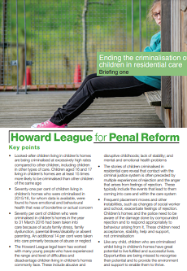
Young people who enter the criminal justice system have long histories of unmet need
In 2019/20, youth offending team practitioners reported concerns about:
the mental health of 72 per cent of sentenced children
the speech, language and communication needs of 71 per cent of sentenced children
the physical health of 47 per cent of sentenced children
the care histories of 46 per cent of sentenced children (Youth Justice Board, 2021a)
Children in residential care are criminalised for offences which parents would not report to the police

Slide 10
Life for young people in prison
2017: Ministry of Justice by Charlie Taylor report found system “not fit for purpose”
2019: Joint Committee on Human Rights found that children’s rights were being breached through the widespread use of solitary confinement and restraint.
2021: The prison inspectorate issued two urgent notifications on secure training centres for children and found prisons are failing to meet the needs of young adults (HMIP, 2021)
Incidents of assault, self harm, solitary confinement and exposure to violence are notoriously high for young people in prison

Slide 11
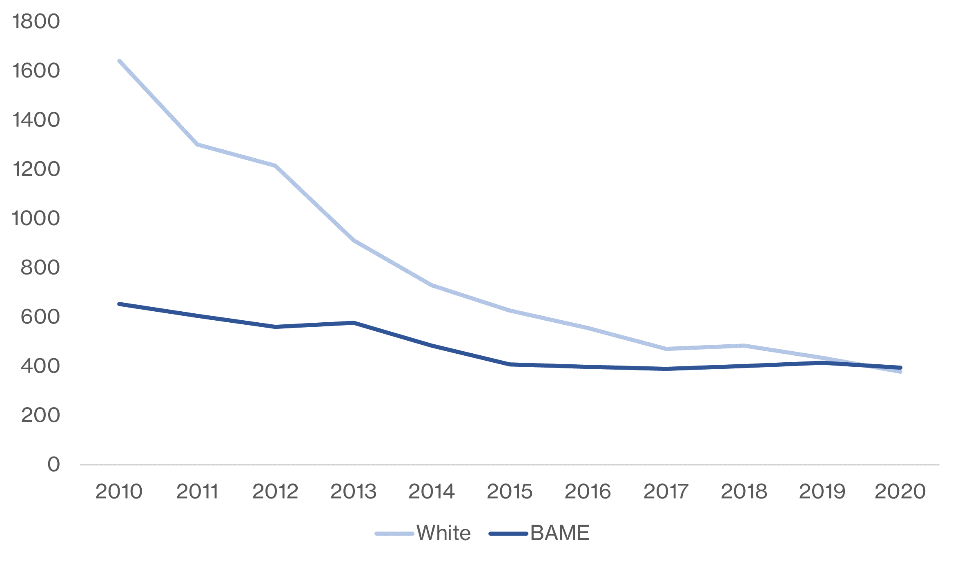
Discrimination in prison

Slide 12
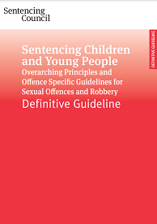
The criminal law is maturing… slowly
The law now recognises that children must be treated as a completely different group from adults, as shown by the Sentencing Council’s definitive guideline on Sentencing Children and Young People (published in 2017)
The law has also begun to recognise the developing maturity of young adults
In the case of Clarke (January 2018), the Lord Chief Justice held that the age of 18 “does not present a cliff edge for the purposes of sentencing … Full maturity and all the attributes of adulthood are not magically conferred on young people on their 18th birthday”.
In October 2019, the Sentencing Council published an expanded explanation of its guideline on age and/or lack of maturity as a mitigating factor

Slide 13
But a whole lot more maturing to do…
The criminal law is still in its infancy
Civil law is more mature but there are enormous problems with access to it
The lack of access to civil rights and result in criminal charges
Public legal education and a rights based culture needs to become normal
Matadeen v Pointu 1998, the Judicial Committee of the Privy Council: treat like, alike and unalike differently
That goes for the law too: civil and criminal need to work in step
The law and the way it works must adapt to meet the needs of young people at every step of the way

Slide 14
References
Centre for Social Justice (2008), Couldn’t Care Less: A policy report from the Children in Care Working Group, https://www.centreforsocialjustice.org.uk/wp-content/uploads/2018/03/CouldntCareLess.pdf
HMIP (2021), Outcomes for young adults in custody: A thematic review, https://www.justiceinspectorates.gov.uk/hmiprisons/wp-content/uploads/sites/4/2021/01/Young-adults-thematic-final-web-2021.pdf
Howard League (2017), Ending the criminalisation of children in residential care: Briefing one, https://howardleague.org/wp-content/uploads/2017/07/Ending-the-criminalisation-of-children-in-residential-care-Briefing-one.pdf
Ministry of Justice (2020), HM Prison and Probation Service offender equalities annual report 2019 to 2020, https://www.gov.uk/government/statistics/hm-prison-and-probation-service-offender-equalities-annual-report-2019-to-2020
Ministry of Justice (2021), Safety in Custody quarterly: update to March 2021, https://www.gov.uk/government/statistics/safety-in-custody-quarterly-update-to-march-2021
Youth Justice Board (2021a), Assessing the needs of sentenced children in the youth justice system: supplementary tables, https://www.gov.uk/government/statistics/youth-justice-statistics-2019-to-2020
Youth Justice Board (2021b), Youth custody report: August 2021, https://www.gov.uk/government/statistics/youth-custody-data

