Slide 2
Young Peoples’ Legal Conference
Is it racist….?
Michael Etienne, Barrister
Garden Court Chambers

Slide 3
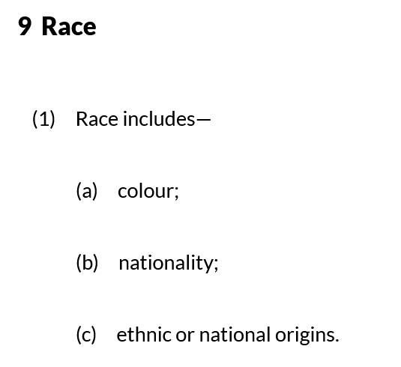
What is race discrimination?
The Legal Meaning:
EqA 2010
Race: EqA 2010 – section 9

Slide 4
What is race discrimination?
The Legal Meaning:
The Human Rights Act 1998 and the European Convention on Human Rights
Articles 2-12 and
Article 14 ECHR

Slide 5
What is race discrimination?
The Legal Meaning:
The Human Rights Act 1998 and the European Convention on Human Rights
Article 14 ECHR:
“The enjoyment of the rights and freedoms set forth in this Convention shall be secured without discrimination on any ground such as sex, race, colour, language, religion, political or other opinion, national or social origin, association with a national minority, property, birth or other status.”

Slide 6
What is race discrimination?
The Legal Meaning:
EqA 2010
Direct discrimination
Indirect discrimination
Harassment
Victimisation

Slide 7
What is race discrimination?
The Legal Meaning:
EqA 2010
Direct discrimination – EqA 2010 s.13
Treating one person worse than another person who is in the same or a similar situation because of their race.

Slide 8
What is race discrimination?
The Legal Meaning:
EqA 2010
Direct discrimination – EqA 2010 s.13
Example:
Joel is a teacher at a local school. He is black. One night, on his way home from work, when he arrives at Hackney Central overground station, he notices that there are a lot of police officers at the exit. He is stopped by an officer and told that he is being stopped and searched because “there’s been a lot of knife crime in the area recently involving other people like you.”

Slide 9
What is race discrimination?
The Legal Meaning:
EqA 2010
Indirect Discrimination– EqA 2010 s.19
Having a policy or way of working that puts people of a racial group or identity at a disadvantage when compared with others and the policy or way of working cannot be “objectively justified.”

Slide 10
What is race discrimination?
The Legal Meaning:
EqA 2010
Indirect Discrimination– EqA 2010 s.19
“A cannot show it to be a proportionate means of achieving a legitimate aim.”

Slide 11
What is race discrimination?
The Legal Meaning:
EqA 2010
Indirect discrimination – EqA 2010 s.19
Example:
Peak Lettings Co rents properties on behalf of landlords in London. They say that they “welcome prospective tenants of all kinds” but their website also says this:
“No DSS: Unfortunately, we are unable to rent properties to people who rely on housing benefit and/or universal credit to pay their rent.”

Slide 12
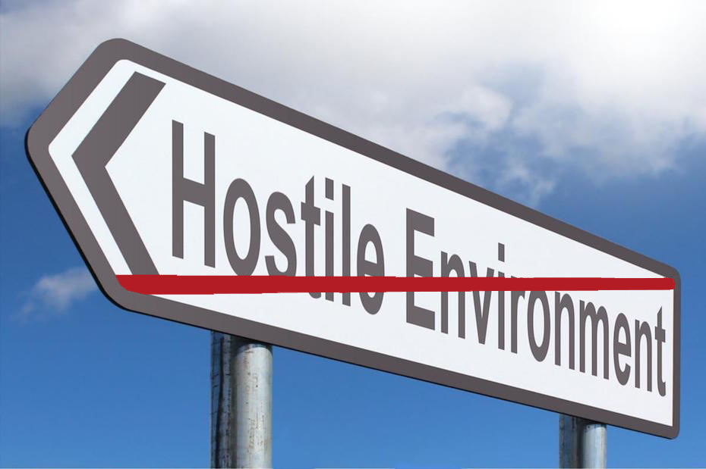
What is race discrimination?
The Legal Meaning:
EqA 2010
Harassment – EqA 2010 s.26

Slide 13
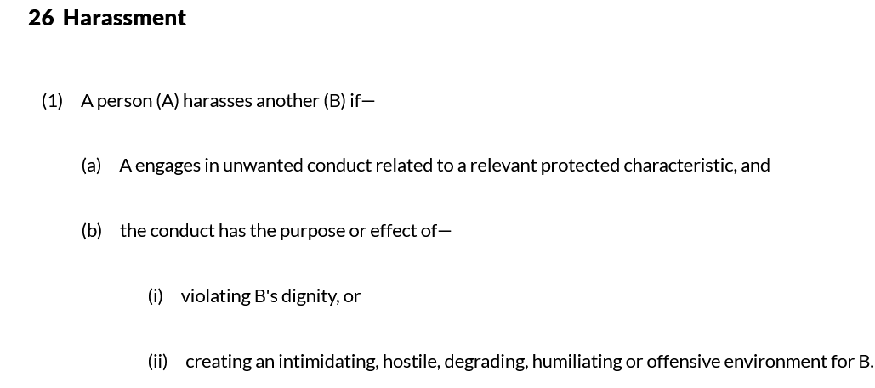
What is race discrimination?
The Legal Meaning:
EqA 2010

Slide 14
What is race discrimination?
The Legal Meaning:
EqA 2010
Harassment – EqA 2010 s.26
Example:
Salman is a British Muslim whose family are from Kashmir. His colleagues make fun of his name and regularly make “jokes” about Salman being a terrorist. Salman has repeatedly asked them to stop this. His colleagues said that he should “lighten up”, that it’s “only banter.” Salman reported this to his line manager who said that if wants to fit in, he should stop “playing the race card.”.

Slide 15
What is race discrimination?
The Legal Meaning:
EqA 2010
Victimisation– EqA 2010 s.27
Punishing someone for objecting to racist treatment or for supporting someone who does.

Slide 16
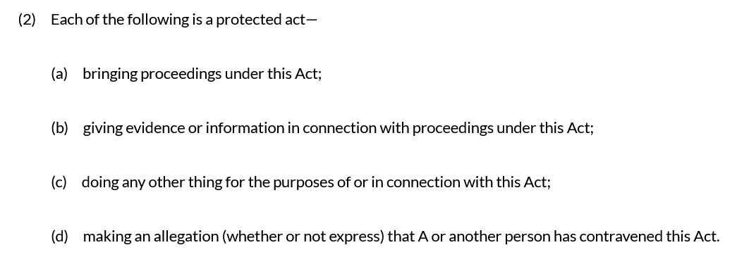
What is race discrimination?
The Legal Meaning:
EqA 2010
Victimisation– EqA 2010 s.27
Punishing someone for objecting to racist treatment or for supporting someone who does.

Slide 17
What is race discrimination?
The Legal Meaning:
EqA 2010
Victimisation – EqA 2010 s.29
Example:
Christian is in the final year of his GCSEs. His least favourite subject is English because his teacher, Mr Jessop, makes him read texts that use the N-word out loud. Mr Jessop also mocks him in front of the class for “talking street”. Christian finds this deeply embarrassing and upsetting. When he reported this to the head teacher, Ms Smith, he was told: “these allegations are obviously ridiculous, an excuse for your poor grades. Christian was then given detention for “bringing the name of a teacher into disrepute.”

Slide 18
Is it racist if it’s “true”?
R (on the application of the European Roma Rights Centre) v Prague Immigration Officer at Prague Airport [2004] UKHL 55
“…If a person acts on racial grounds, the reason why he does so is irrelevant…The law reports are full of examples of obviously discriminatory treatment which was in no way motivated by racism or sexism and often brought about by pressures beyond the discriminators' control: the council which sacked a black road sweeper to whom the union objected in order to avoid industrial action…the council which for historical reasons provided fewer selective school places for girls than for boys…

Slide 19
Is it racist if it’s “true”?
R (on the application of the European Roma Rights Centre) v Prague Immigration Officer at Prague Airport [2004] UKHL 55
“But it goes further than this. The person may be acting on belief or assumptions about members of the sex or racial group involved which are often true and which if true would provide a good reason for the less favourable treatment in question. But '[w]hat may be true of a group may not be true of a significant number of individuals within that group’…

Slide 20
Is it racist if it’s “true”?
R (on the application of the European Roma Rights Centre) v Prague Immigration Officer at Prague Airport [2004] UKHL 55
“'The mistake that might arise in relation to stereotyping would be a supposition that the stereotype is only vicious if it is untrue. But that cannot be right. If it were, it would imply that direct discrimination can be justified …”

Slide 21
So what now?

Slide 22
Thank you
020 7993 7600 michaele@gclaw.co.uk @gardencourtlaw

